Slide 1

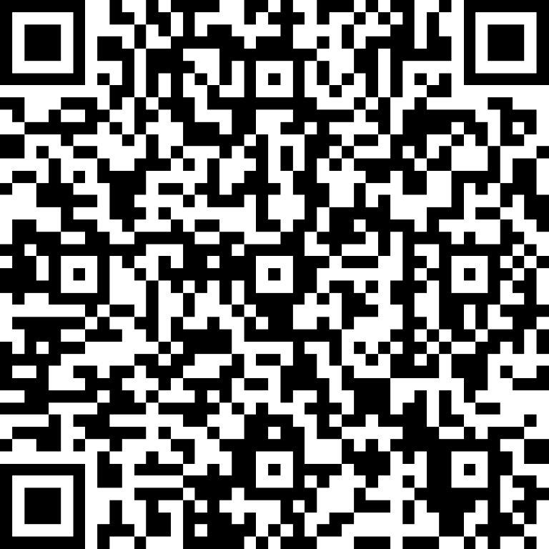
Extra-Curricular Clubs Participation
Scan Me

